Slide 1
Predictive Hiring
Jaya Devi Naraharisetty

Slide 2
Agenda
Methodology
Feature Selection
Model Selection
Model Evaluation
Conclusion

Slide 3
Methodology
The project aims to predict candidates hiring likelihood.
Business Understanding
Analytic Approach
Data collection & Preparation
Modelling
Evaluation
Identifying hiring likelihood.
Predictive model for classification.
Received data from HR department.
Handling missing, null and duplicate values, feature engineering to provide additional insights to ML model.
Passing data to multiple classification algorithms and fine-tuning parameters to identify the best model.
Calculating accuracy of model for unseen data.

Slide 4
Feature Selection
Data Set Analysis
Data set contains 690 candidates with 15 fields(features) which are anonymized and a target variable.
Features contain categorical data and numerical data. Out of 15 fields 9 are categorical and 6 are numerical.
Target variable contains 2 values 1,0. 1 is success and 0 is failure.

Slide 5
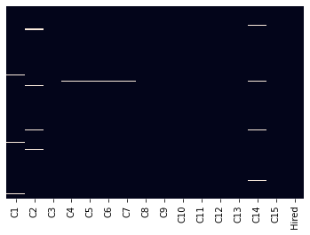
Feature Selection
Data Cleaning
Heat map of ‘?’ values
Data set doesn’t contain explicit null values or duplicate values. But we have ‘?’ which needs to be handled.
Handled by imputing categorical variables with most frequent value and numerical values with median

Slide 6
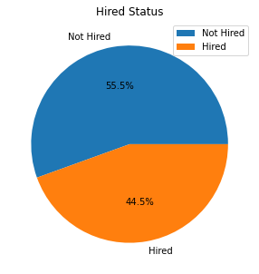
Feature Selection
Exploratory Data Analysis
Data set is balanced.
Splitting Data set into categorical and numerical data sets.
Categorical Dataset : C1, C4, C5, C6, C7, C9, C10, C12, C13
Numerical Data set: C2, C3, C8, C11, C14, C15

Slide 7
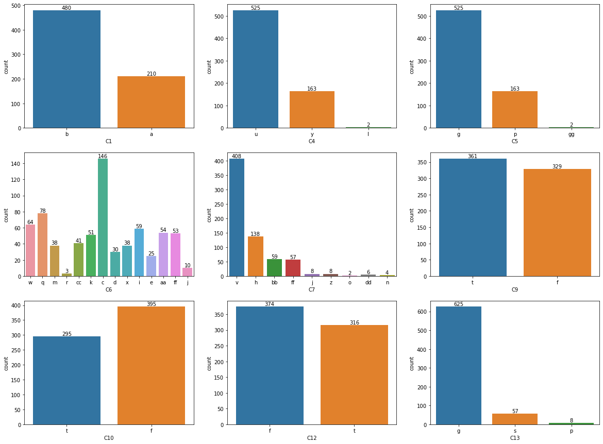
Feature Selection
EDA on Categorical Dataset
C4, C5 distributions are same, C5 is dropped.
C6, C7 have multiple values, C6 is dropped and C7 dimensionality is reduced.
C4, C13 have a value which has very low frequency and low value is ignored.
Categorical data is converted into numerical using one hot encoding technique.

Slide 8
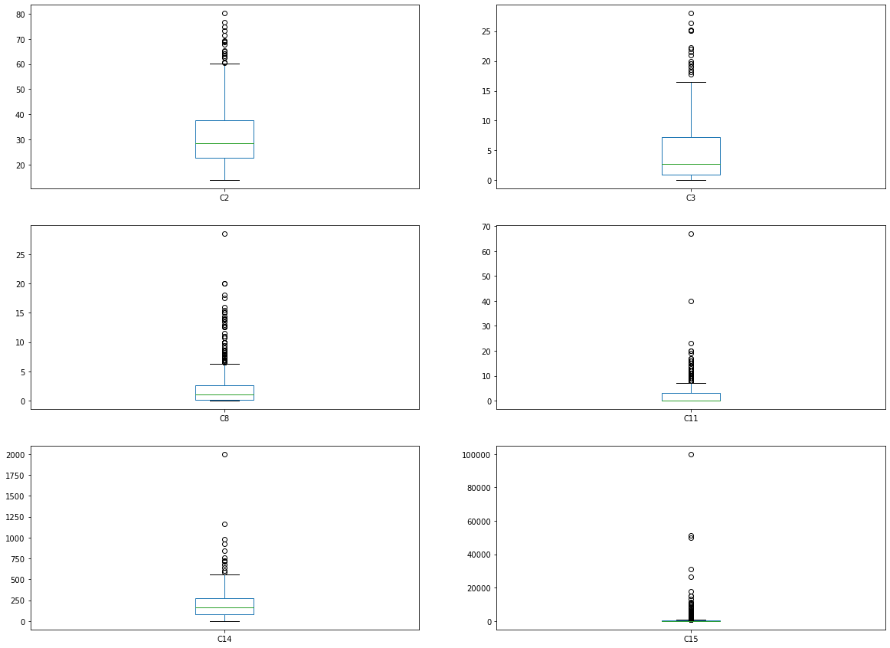
Feature Selection
EDA on Numerical Dataset
All features have high number of outliers.
Outliers are handled using power transformer and imputing with mean.

Slide 9
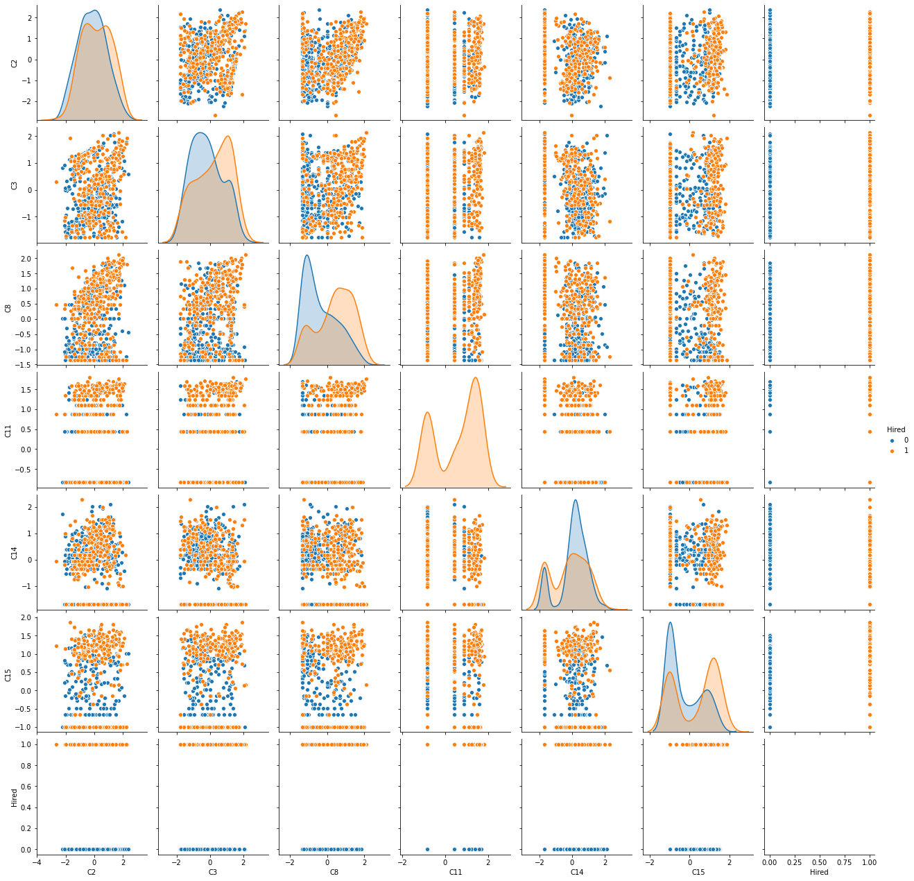
Feature Selection
EDA on Numerical Dataset
Feature variables resemble almost gaussian distribution and this is good to be applied to any ML model.
Univariate and bivariate analysis showing complex relation.

Slide 10
Model Selection
Performance of ML classification algorithms
ML classification Models are applied on dataset and cross validation score is calculated with default parameters and fine tuned hyperparameters.
Random forest performed best with default and xgboost is best with tuned parameters.
Model | Baseline | Tuned Performance
Naive Bayes | 85.6% | NA
Logistic Regression | 85.8% | 86.2%
Decision Tree Classifier | 83.3% | NA
K Nearest Neighbor | 80% | 87.6%
Random Forest | 88.5% | 88.7%
Support Vector Machine | 86% | 86.2%
Xtreme Gradient Boosting | 87.3% | 89.1%

Slide 11
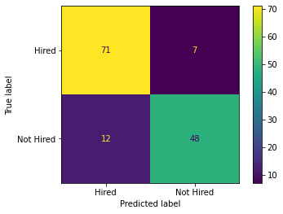
Model Evaluation
Performance of ML model
Model | Accuracy
Xtreme Gradient Boosting | 83%
Random Forest | 84%
Ensemble Model | 86%
Unseen Data is passed to Random Forest, XG Boost, Ensemble models.
Accuracy is considered as evaluation metric as our target is well balanced.
Ensemble model with all ML models has highest performance with an accuracy of 86%
Confusion matrix describes our ensemble model has performed reasonably well.

Slide 12
Conclusion
For Predicting the likelihood of hiring, classification ML models are used and is performed best with an accuracy of 86% using ensemble model with K-Nearest Neighbors, Random Forest, Support Vector Machine, Extreme gradient boost and logistic regression models.

